Slide 1
Graphs and Data Interpretion
Chengjun Liu
September 14, 2019

Slide 2
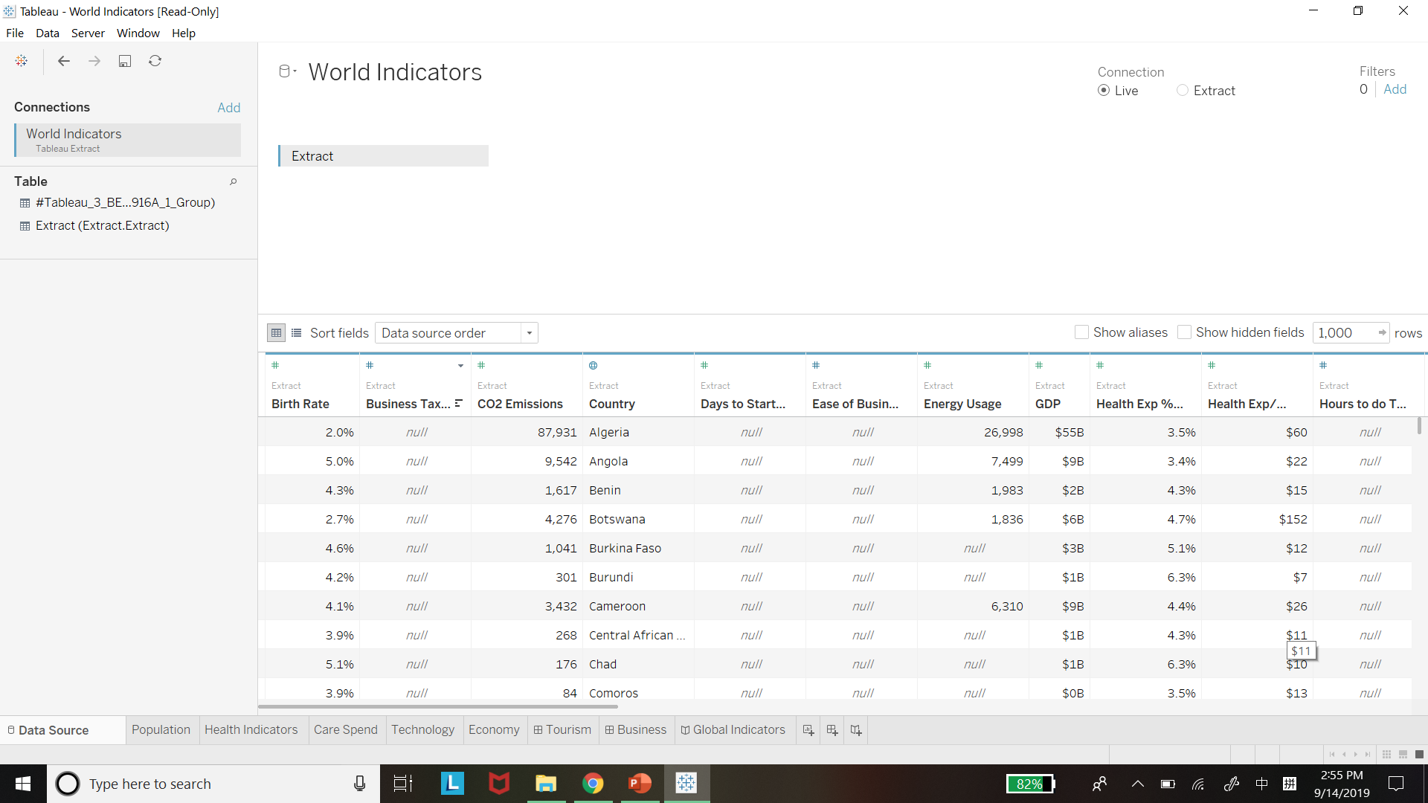
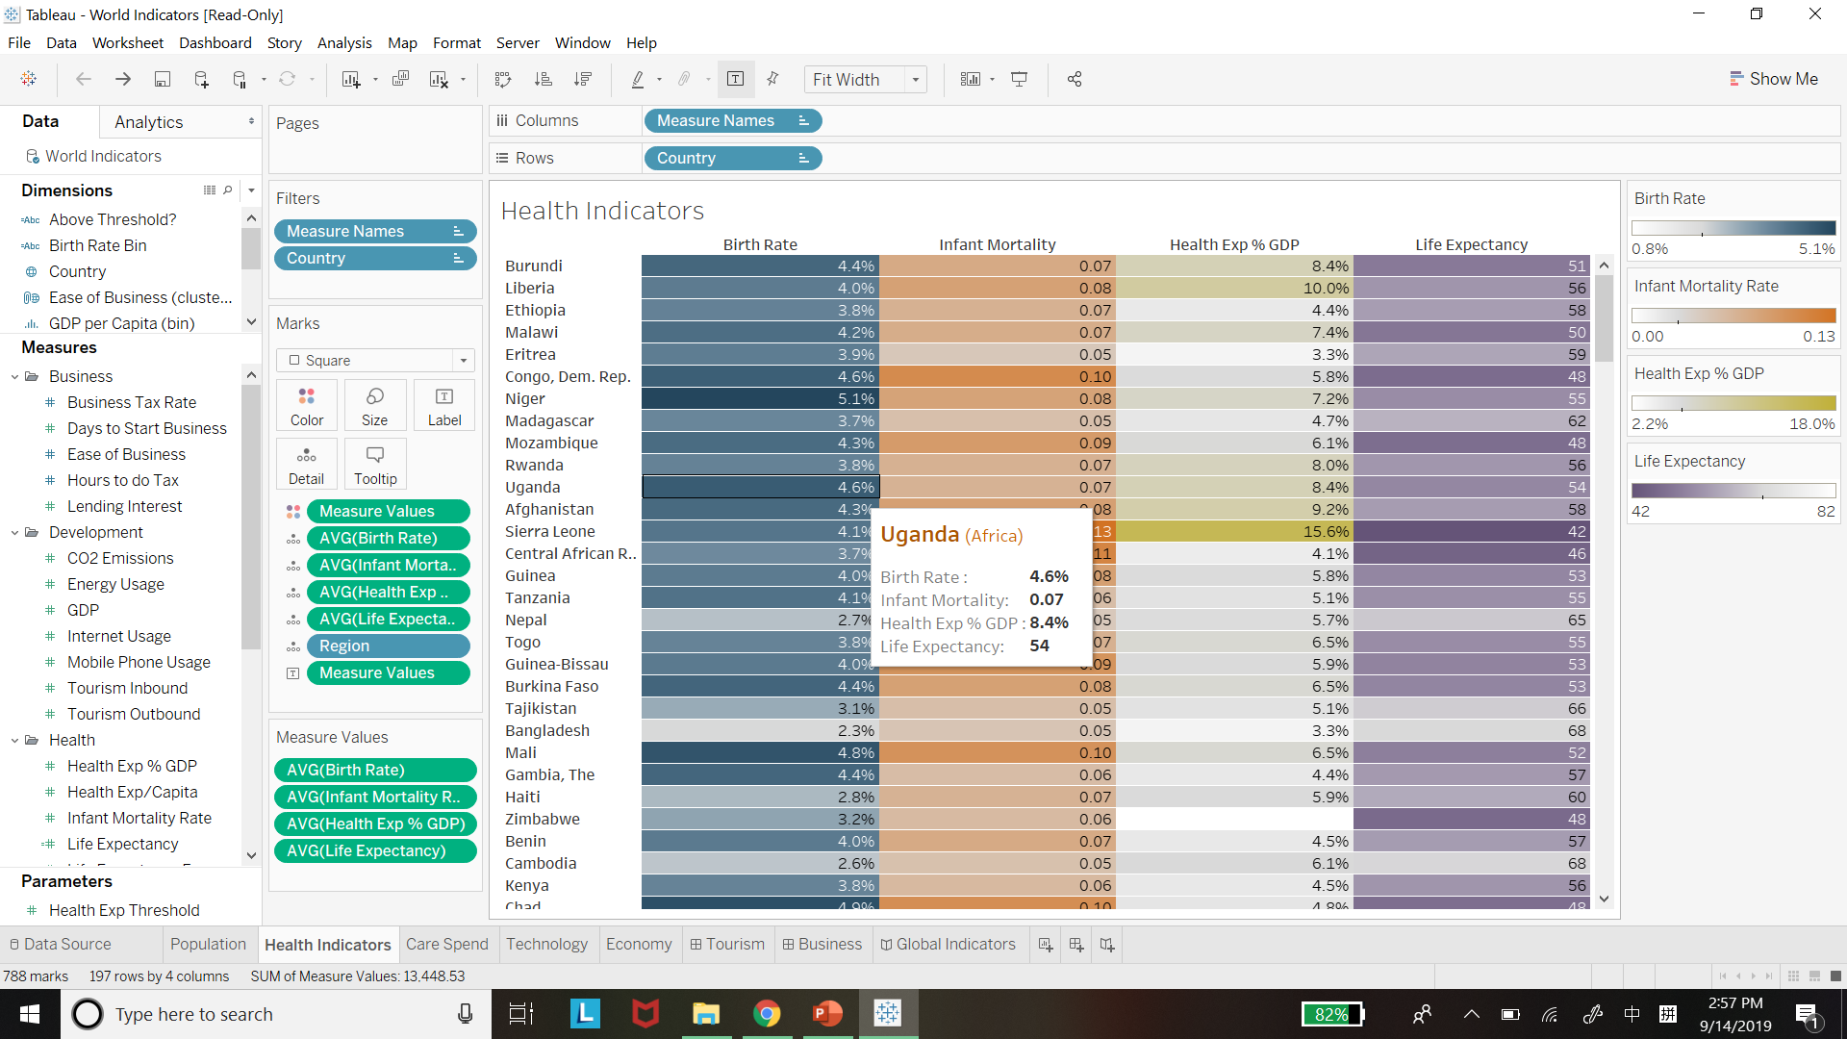
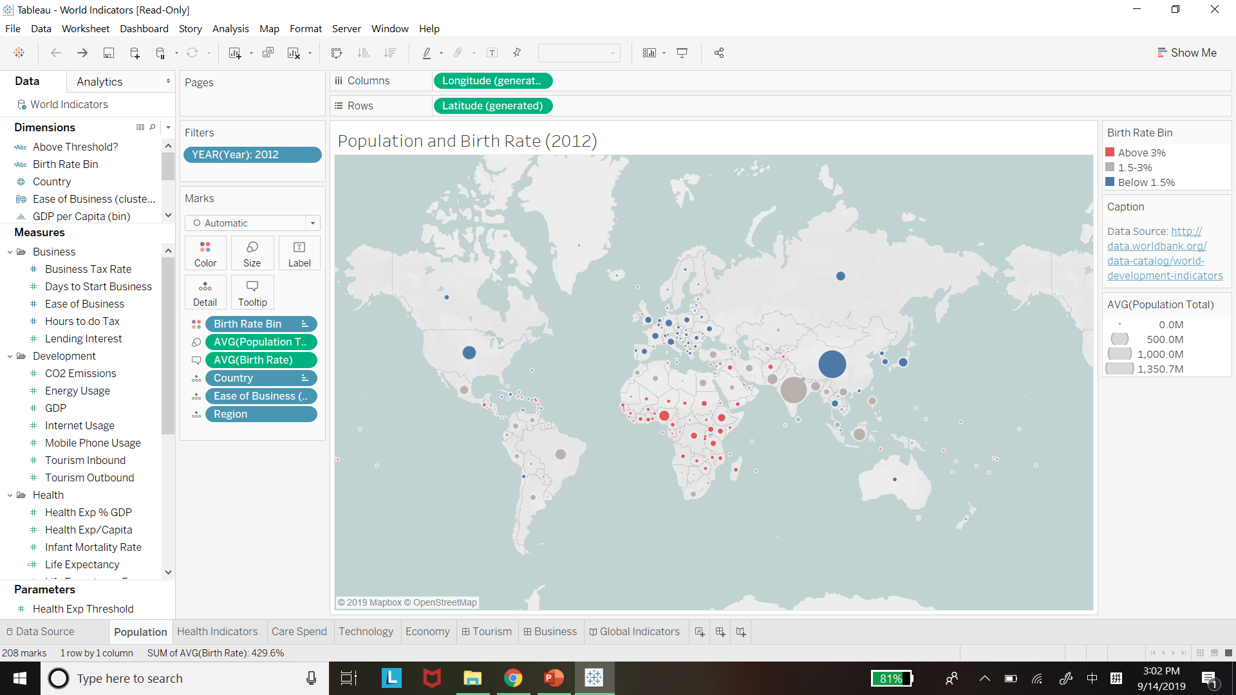
Why Graph Important?
“What are you going to show us…?”
“But I still don’t know whose birth rate is higher…”
“Got it, African birth rate is higher!”
The clearer your graph is, the easier your data interpretation is!

Slide 3
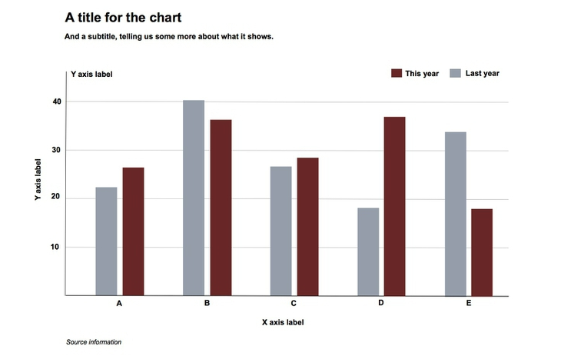
Anatomy of a Graph
Title tells you what it talks about
Legend tells you what data bars refer to
Subtitle gives more information(time, region, etc.)
X Axis Tells you which factors bars are
Y Axis measures how much factors are
Unit marks name and quantity of factors
Footnote: more information, especially for reference

Slide 4
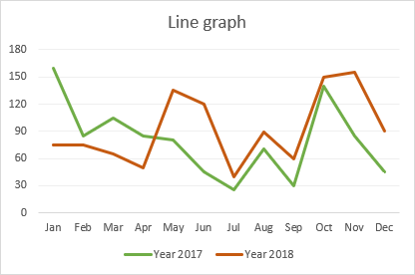
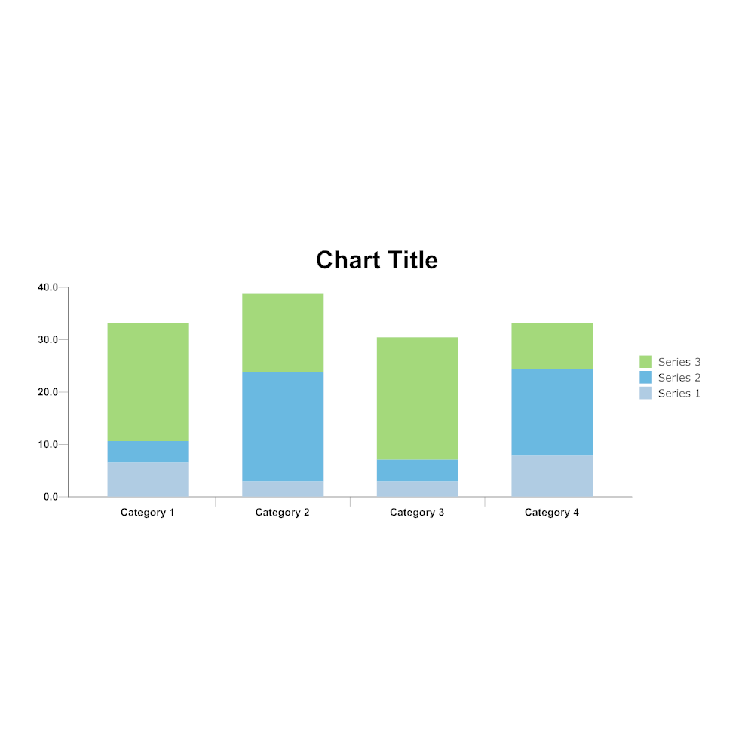
Line Graph\Bar Chart
How things change with time?
Which compares to be larger?

Slide 5
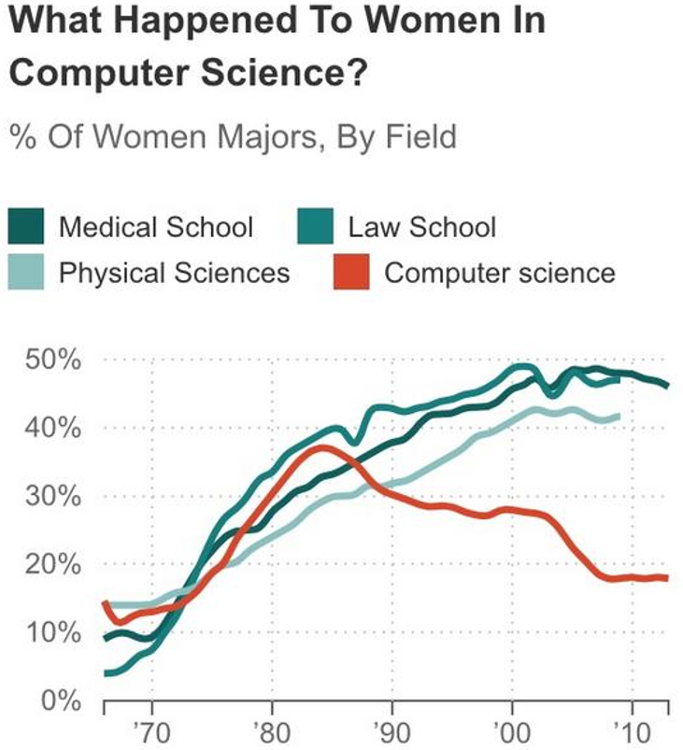
3-Step Interpretation
Step 1: Scan. Quickly run through the anatomy.
“Oh, it’s talking about women in computer science and comparing the populations of majors…”
Step 2: Extract. Distill insights by looking at and comparing specific data subsets.
“Oh, the percentage of women in computer science dropped dramatically and is lower than other majors…”
Step 3: Apply. Solve the question with extract.
“Women in computer science become less due to some serious problem. We must figure it out and stop the trend…”

